Slide 1
ISBM COLLEGE OF ENGINEERING
ROAD ACCIDENT ANALYSIS
Shivansh Gautam
Prashant Kumar Singh
Prince Kumar Singh
Sonal Raj
Guided By: Prof. Veer Bhadra Pratap Singh
H.O.D : Prof B.B Gite

Slide 2
TABLE OF CONTENTS
Introduction
Problem Statement
Why this topic?
What’s our solution
Objective
Assumptions and dependencies
System Architecture
Data flow
Future of the project

Slide 3
Introduction:
Accident-related fatalities and injuries are predicted to be an increasingly common problem. Since the invention of the vehicle, traffic safety has been a major problem. In India, road accidents claimed the lives of 1,53,972 individuals in total in 2021, according to the Ministry of Road Transport and Highways (MoRTH). Statistics have also shown that young individuals, who make up a significant portion of the workforce, have a relatively high death rate in traffic accidents. Various road safety measures are required to solve this issue. Research interest in figuring out the important impact of the severity of accidents caused by traffic accidents. The prime goal of this research paper is to analyze road accidents and determines the severity of an accident by applying advanced machine learning techniques.

Slide 4
TO HANDLE THE ENORMOUS NUMBER OF ROAD ACCIDENTS IN INDIA A PRECISE ANALYSIS IS REQUIRED. THIS ANALYSIS WILL BE DONE MORE DEEPLY TO DETERMINE THE INTENSITY OF ROAD ACCIDENTS BY USING DIFFERENT MACHINE LEARNING TECHNIQUES LIKE SUPERVISED LEARNING, UNSUPERVISED LEARNING, ETC. MACHINE LEARNING IS AN EFFECTIVE TOOL THAT CAN BE USED TO EXAMINE DATA ON TRAFFIC ACCIDENTS AND SPOT TRENDS THAT ARE DIFFICULT TO SPOT WITH THE UNAIDED EYE. MACHINE LEARNING CAN HELP TO MAKE OUR ROADS SAFER BY IDENTIFYING THE FACTORS THAT CAUSE ACCIDENTS AND CREATING INTERVENTIONS TO ADDRESS THESE FACTORS.
Problem statement

Slide 5


Why this topic

Slide 6
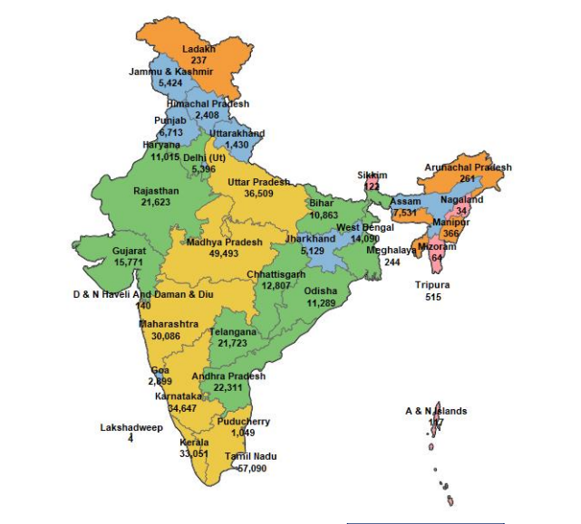
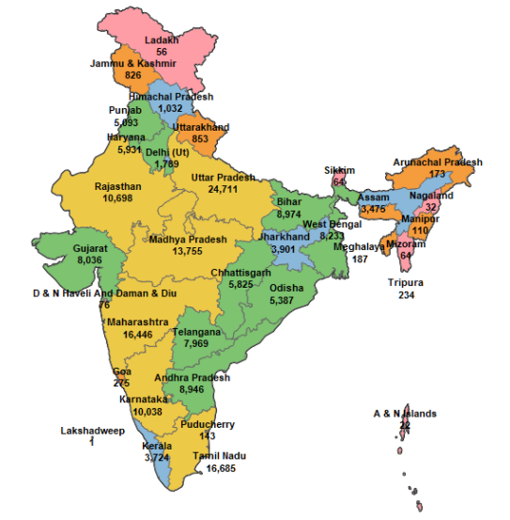
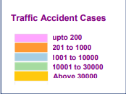
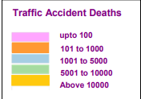
Map report
STATE/UT – WISE TRAFFIC ACCIDENTAL
DURING 2021
STATE/UT – WISE TRAFFIC ACCIDENT DEATHS DURING 2021

Slide 7
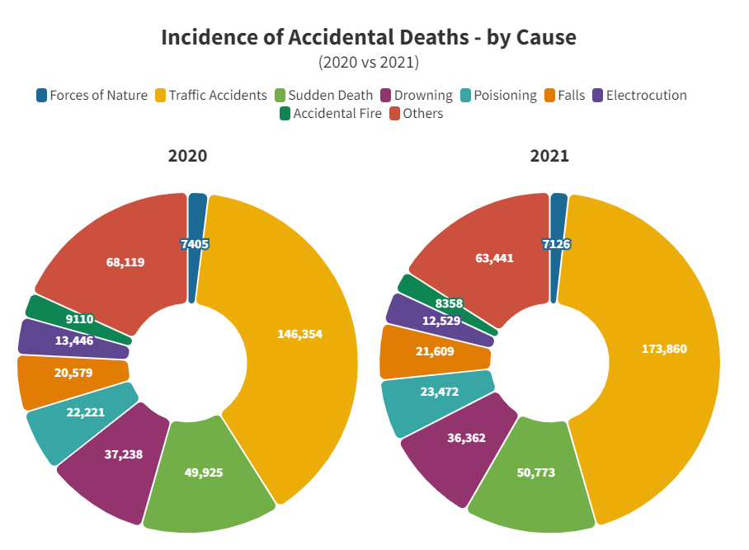

Slide 8

What’s our solution
An ML-powered web app that predicts accident severity based on the current conditions. It is trained with 25 Thousand accident records over 2010-2021. More data means greater accuracy. The purpose of such a model is to be able to predict accidents based on the conditions that will be more prone to accidents, and therefore take preventive measures. We will even try to locate more precisely future accidents in order to provide faster care and precautionary service.
We will train our model with multiple algorithms and only choose the best one with high accuracy. This will ensure that our model is as accurate as possible and can provide the most accurate predictions.

Slide 9
Objective
1. To study the causes of the accident by features extraction.
2. To understand the severity of the accident based on these features.
3. To classify it as fatal, grievous, simple injury or motor collision.
4. To carry out algorithms to predict the performance and accuracy of each.
5. To conclude the fastest algorithm.
6. To understand the effect of each feature on the accident and conclude how much is it responsible for the accident.

Slide 10
ASSUMPTIONS AND DEPENDENCIES
Data quality: The quality of the data used to train the model is critical. The data should be accurate, complete, and representative of the real world.
Bias: The model should be free of bias. The model should not be biased against any particular group of people.
Here are some of the assumptions and dependencies that we have to consider while creating an analysis model using machine learning:-
Model complexity
The complexity of the model should be appropriate for the data. A complex model may be more accurate, but it may also be more difficult to train and interpret.
Training data: The training data must be accurate and realistic. A wide range of potential accident-causing variables, such as driver behaviour, road conditions, and weather, should be included in the data.

Slide 11
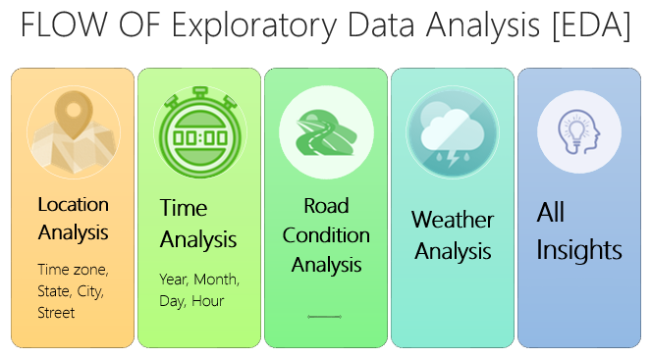
These are the factors that we need to consider while selecting the dataset and model building

Slide 12
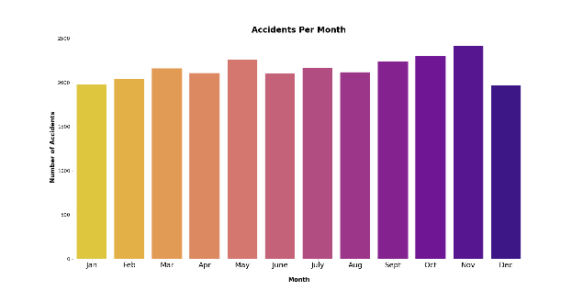
Data Mining:
DATA PRE-PROCESSING:
A key stage of the data mining process is data preparation. It is the process of preparing raw data for analysis by cleaning, formatting, and other changes.
DATA GATHERING:
We will use a variety of sources to gather data for machine learning, including Kaggle. Kaggle is a great resource for finding high-quality data sets
Here are some of the steps involved in data mining. Which transform a data into something which can be understand by human and can be used in ML algorithms to build an model.
DATA VISUALIZATION:
The visual representation of data is known as data visualization. Data patterns and trends that would be challenging to spot would be made visible in this process.

Slide 13
FEATURE SELECTION:
We used the chi-square test and visualization of various features to see which of the features are important for model building. The chi-square test is a statistical test that is used to determine the independence of two categorical variables. We used the chi-square test to see if there was a significant relationship between each feature and the accident severity.

Slide 14
FEATURE SELECTION:
We used the chi-square test and visualization of various features to see which of the features are important for model building. The chi-square test is a statistical test that is used to determine the independence of two categorical variables. We used the chi-square test to see if there was a significant relationship between each feature and the accident severity.

Slide 15
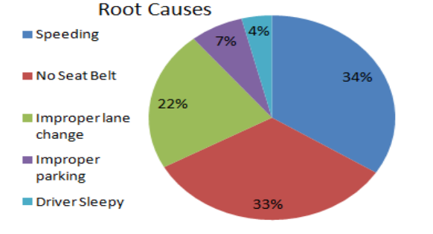
SPEED Limit
In 2021, road accidents claimed the lives of 1.55 lakh Indians an all-time record. Nearly 60% of those incidents were caused by overspeeding.
(in 2021)
--Times of India report
In 2020

Slide 16
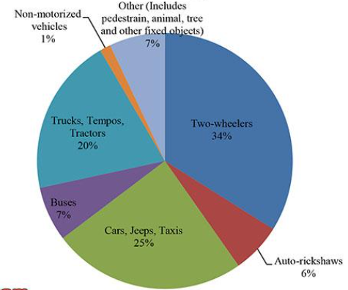
Type of Vehicle
Help us to analyze which type of vehicle is most vulnerable to an accident at that particular location or area

Slide 17
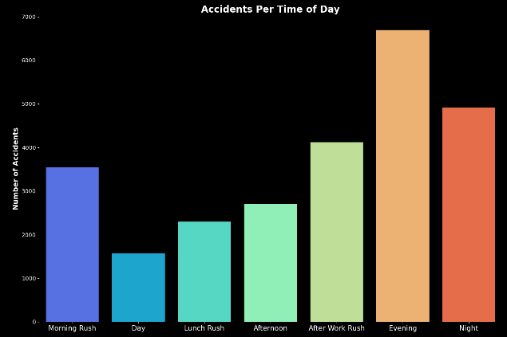
Time
we have Start Time & End Time for the timings of each accident. Start Time shows start time of the accident in local time zone. End Time shows end time of the accident in local time zone. End time here refers to when the impact of accident on traffic flow.
67% road accidents take place between 9AM and 9PM

Slide 18
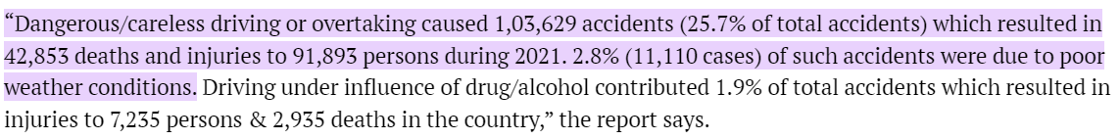
Weather
2.8% (11,110 cases) of such accidents were due to poor weather conditions.
we have collected data for each accident records. Here we will analyse features based on the no. of cases for each distinct Condition. Analyse the current state of the atmosphere and using an understanding of atmospheric processes to predict the safety measure
--News 18 article snapshot

Slide 19
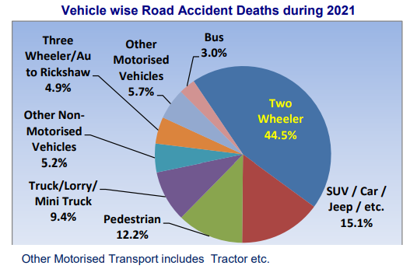
LOCATION
we have different attributes like City, State, and even street for each accident records. Here we will analyze These features based on the no. of cases for each distinct location.
Blind-spot
Slope
Heavy traffic
Crowded place
Which type of Vehicle is involved
at that location?

Slide 20
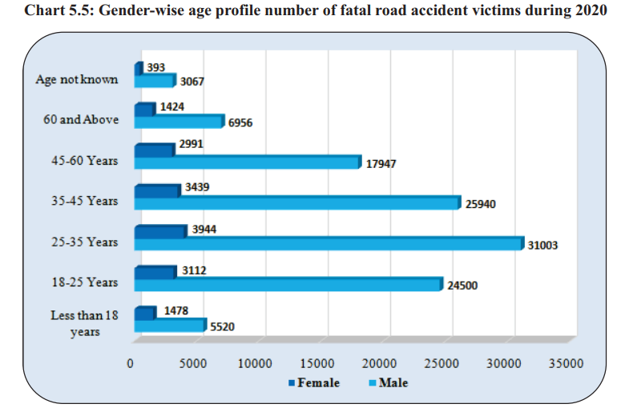
Age group involved in Accident

Slide 21
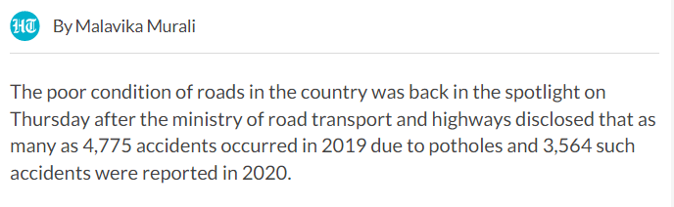
Road condition Analysis
--Hindustantimes

Slide 22
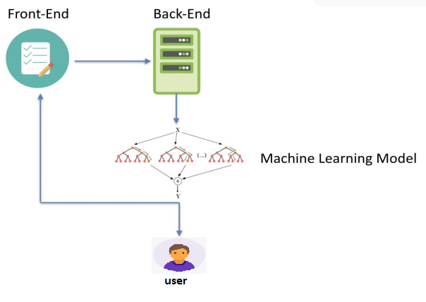
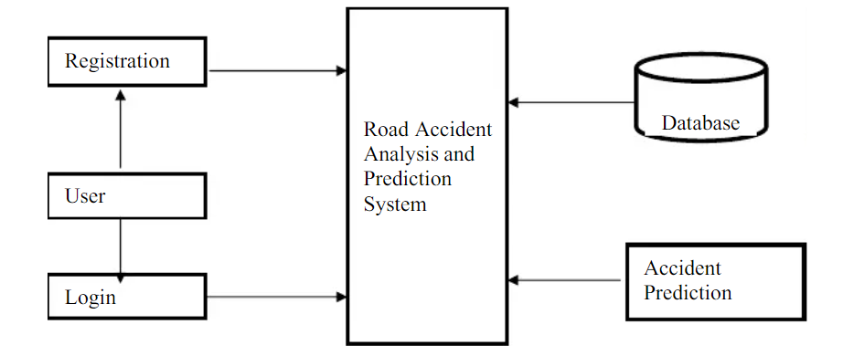
System architecture

Slide 23
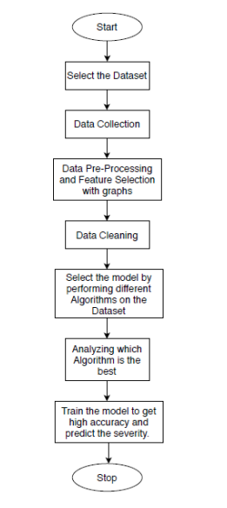
Data-flow Diagram

Slide 24
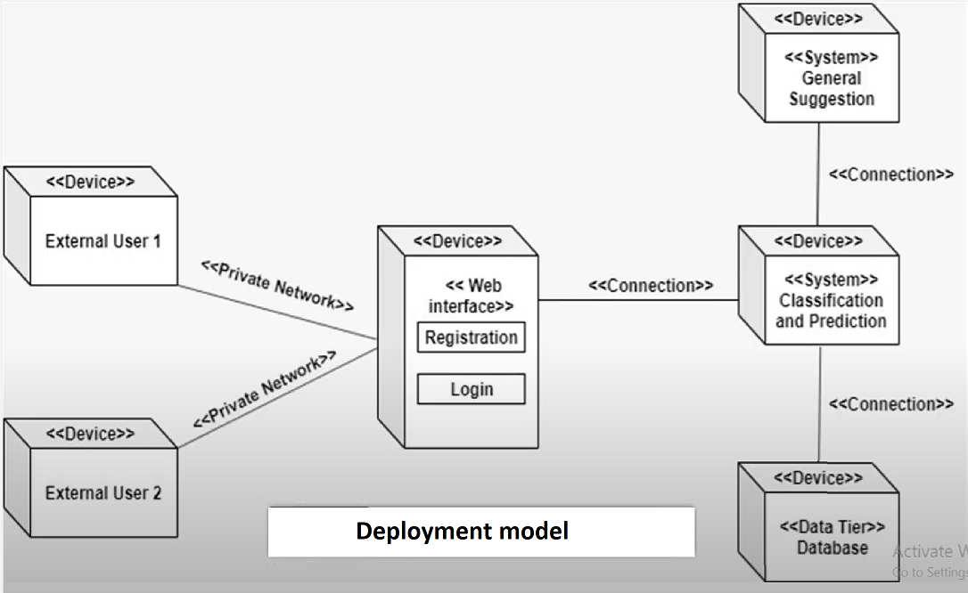
Deployment Model

Slide 25
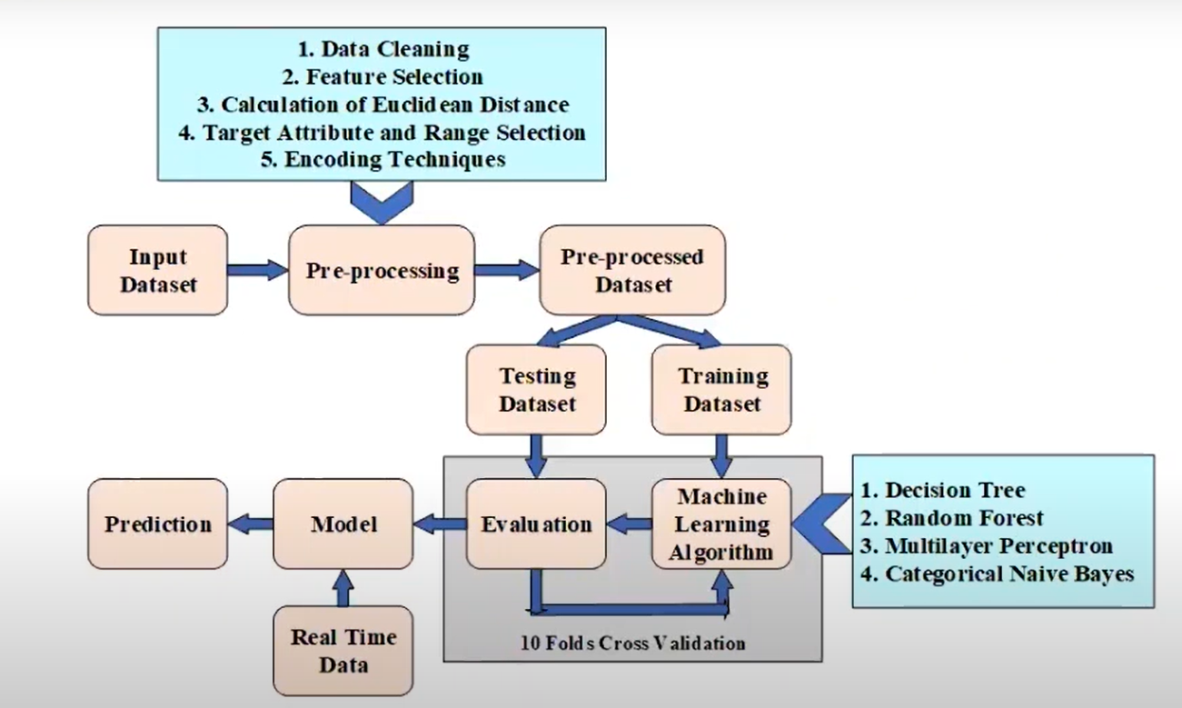
Overall ML model process

Slide 26
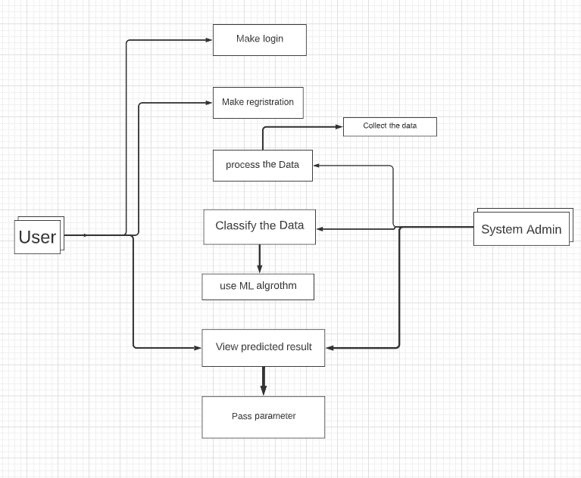
Use case diagram

Slide 27
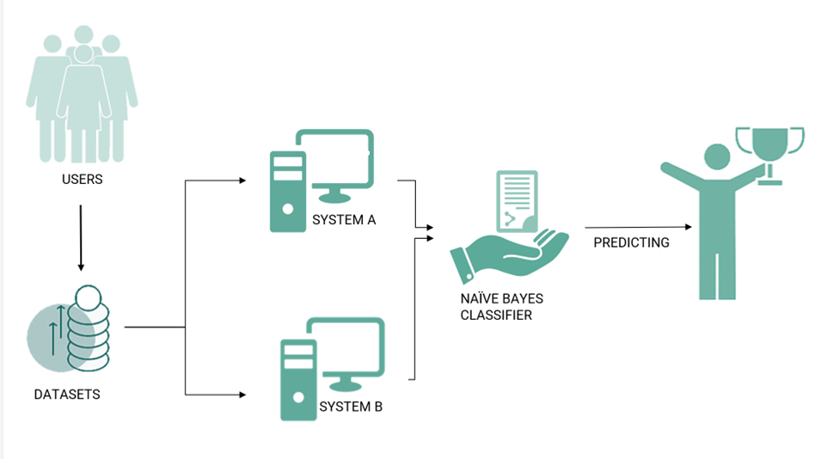

Slide 28
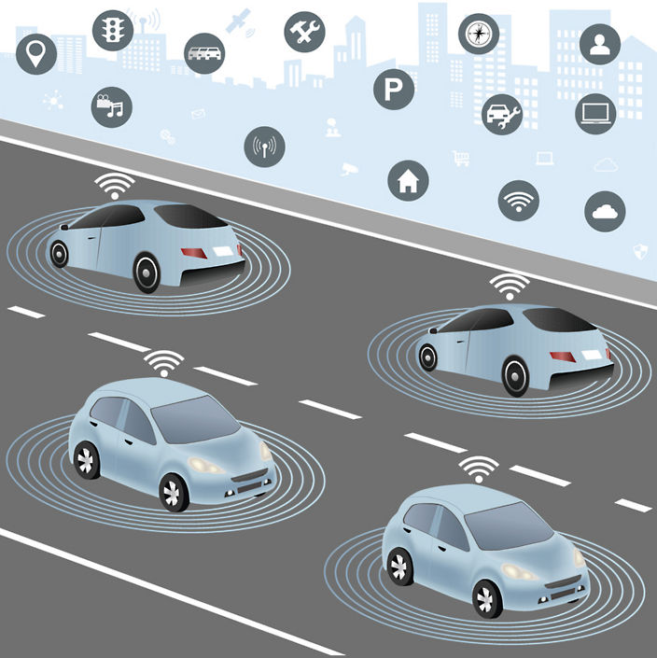
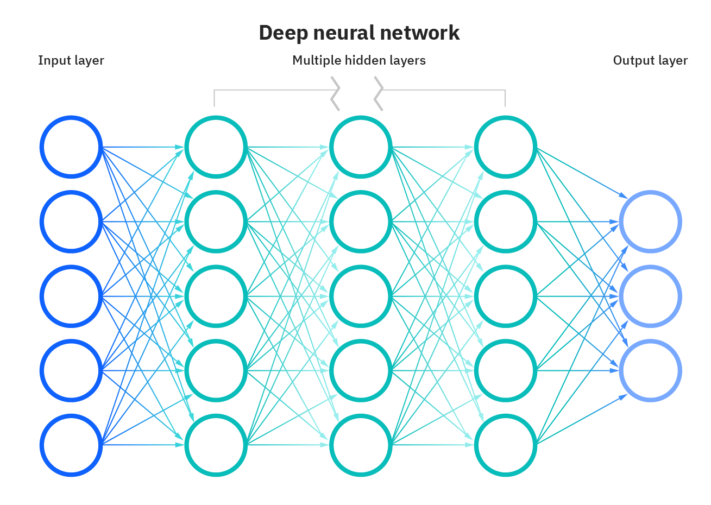
Future of this Project and improvement

Slide 29
References
https://ncrb.gov.in/sites/default/files/ADSI-2021/ADSI_2021_FULL_REPORT.pdf
https://data.gov.in/
https://timesofindia.indiatimes.com/
https://morth.nic.in/road-accident-in-india

Slide 30


